Slide 1
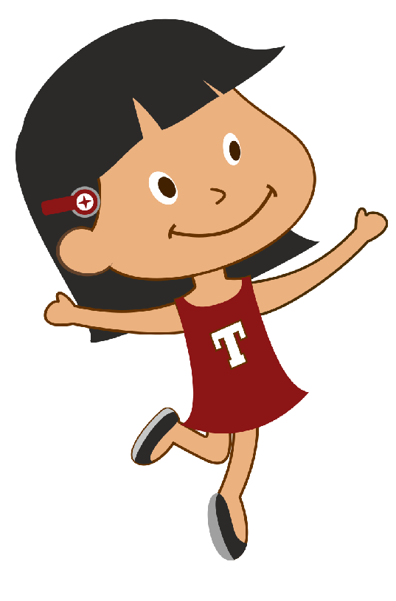

<Insert Header>
Hi I am Tina.
Lets learn how to tell people our name when asked.
Click on the play button to get started.
Tina
Here have auto play option only as default.

Slide 2
<Insert Header>
First someone will ask us our name by saying:
What is your name?
<insert gif – tina mom with speech bubble>
<insert image – tina>
Here have auto play option only as default.

Slide 3
<Insert Header>
Then we need to tell them our name. My name is Tina – so I will say:
Tina
Then we need to tell them our name. My name is Rahul – so I will say:
Rahul
<insert image – tina mom >
<insert gif – tina with speech bubble >
Here have auto play option only as default.

Slide 4
<Insert Header>
Now just like me – can tell your name when asked?
Click on the play button to get stared
<insert gif – talking talking>
Here have auto play option only as default.

Slide 5
<Insert Header>
Hi I am Tina.
Lets learn how to tell people our name when asked.
Click on the play button to get started.
Tina
Here have auto play option only as default.

Slide 6

<Insert Header>
What is your name?
Here have auto play option only as default.
<insert image>

Slide 7
<Insert Header>
Did your child tell you their name when asked?
Here have auto play option only as default.
YES
NO
>
>

Slide 8
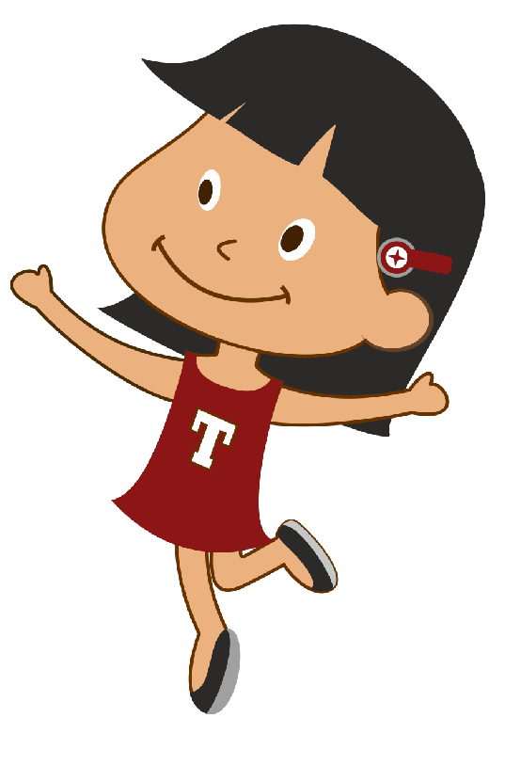
You have completed SpeakBook time! Awesome!
Ill see you later.
Good bye
Speakbook – answering questions – what is your name

